Slide 1
Pilot-Project
Digital Education
Providing digital learning opportunities for children and enabling them to apply acquired knowledge to real-life projects

Slide 3
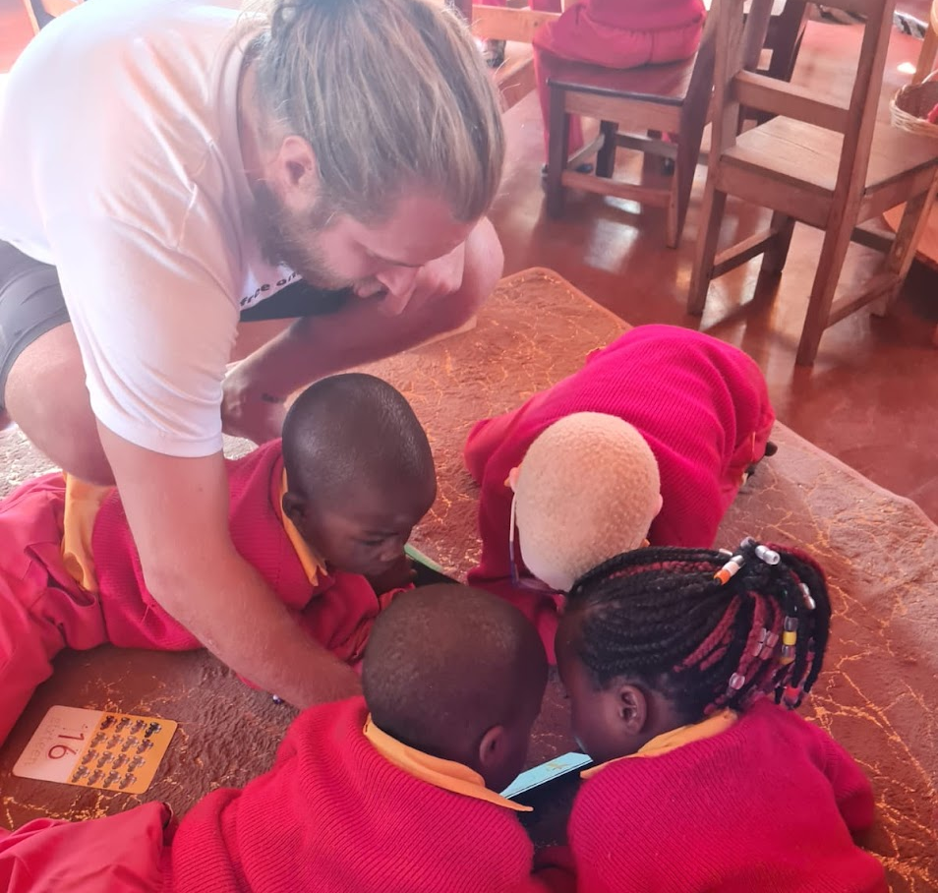
Digital Literacy - Empower Every Child! Building a Computer Lab at Bongai Shamwari – Mutare, Zimbabwe
What is the project about - project overview:
How can you support:
This pilot project marks the beginning of a transformative approach to education by empowering children globally with free access to education through technology About the project
At Bongai Shamwari in Mutare, Zimbabwe, we are establishing a computer lab to foster digital literacy equipping children with the essential competencies they need to navigate and thrive in the digital age responsibly
The project emphasizes building foundational digital competencies, particularly in effective and safe technology use:
Basic Computer Skills: Introduce students to essential hardware, software, and internet navigation techniques to build foundational digital competencies
Critical Thinking & Problem-Solving: Engage students in project-based digital activities to identify, analyze, and resolve issues using digital tools and strategies effectively
Digital Ethics: Foster responsible online behaviour by helping children understand digital safety and creating a secure digital experience
Companies: Financially or sponsor equipment
Individuals: Financially or volunteer
Scan for more information or on the next page and here
Affiliated Sponsors:
Join us! Your logo could be here
How funds will be used:
Physical Installation ($10k required)
Room setup, incl. electricity and renovations of the room
Implementation of security measures for the facility
Hardware and Software Setup ($10k required)
Purchase of hardware and software
Technical setup, including maintenance and ongoing tech support
Teacher Salaries and Training ($20k required)
Salaries for teachers and staff
Development and delivery of training programs for educators
$ 40k will ensure the project is adequately funded for the next 2 years
Why it matters and the direct impact:
*
By 2030, 90% of jobs will require digital literacy, yet 2.7 billion people are still offline; addressing this gap is critical, especially as 2/3 of children lack internet access at home and 60% of children face cyber risks
Skill Development: Your support will equip underserved students and teachers with digital competencies, empowering them to thrive in today's tech-driven world and future job market
Access to Knowledge: Your contribution will provide students and teachers with unlimited online educational resources, democratizing learning and bridging the digital divide
Transforming Education: Your donations will establish a fully operational pilot computer lab, creating a scalable model and a sustainable, long-term learning center strengthened through local partnerships
Who are we and contact details:
Bongai Shamwari e.V.: Kindergarten and primary school in Mutare, Zimbabwe
ctwp educational empowerment: Initiative providing free education globally
Lars Gottwals
Christa Zeller
ctwp.ee@gmail.com
Bongaishamwari@gmail.com
+41 79 815 50 20
+49 160 920 37 999
*Source: Lars visiting Bongai Shamwari in May 2023, using his smartphone to teach the alphabet with the application Khan Academy Kids

Slide 4
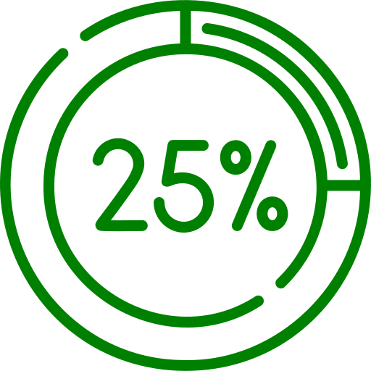
As a Company
Be part of the Computer Lab project in Zimbabwe!
Monitor $125
Software License
$250
Internet - 6 month $500
Empower children for tomorrow – contribute today!
Open a window to endless knowledge with a new computer monitor
Equip learners with cutting-edge software to fuel their educational journey
Connect an entire school to a world of online resources and limitless opportunities
Donate
Donate
Donate
At Bongai Shamwari School, we are establishing a computer lab to teach kids digital literacy:
Computer skills
Digital problem-solving
Safe online behaviour
Your support can help bridge the digital divide!
Desks * $750
Solar Panels $1’250
Solar Battery $2’500
Offer a whole class a space that promotes concentration and effective learning
Invest in sustainable energy, to keep classrooms bright and learning alive
Power up our school with reliable, green energy storage to keep classrooms running
Donate
Donate
Donate
Scan me:
Teacher - 1 year $6’000
25% of the project $10’000
Choose your Contribution
Sponsor a teacher for an entire year and provide quality education
Be a cornerstone sponsor and drive a quarter of this transformative initiative
Let your generosity decide on your contribution to support the school
Donate
Donate
Donate
*All chairs and desks are going to be produced locally to benefit the community

Slide 5
As an Individual
Be part of the Computer Lab project in Zimbabwe!
PC Mouse $7
Keyboard $15
Chair * $30
Empower children for tomorrow – contribute today!
A small gift, a big impact—provide a child with a tool to navigate the digital world
Equip a child with the power to transform ideas into digital creations
Create a comfortable learning environment where a child can thrive
Donate
Donate
Donate
At Bongai Shamwari School, we are establishing a computer lab to teach kids digital literacy:
Computer skills
Digital problem-solving
Safe online behaviour
Your support can help bridge the digital divide!
Desk * $50
Monitor $125
Internet - 3 month $250
Offer a child a space that promotes concentration and effective learning
Open a window to endless knowledge with a new computer monitor
Connect an entire school to a world of online resources and limitless opportunities
Donate
Donate
Donate
Scan me:
Teacher - 1 month $500
Teacher - 2 month $1’000
Choose your Contribution
Want to make a difference? Volunteer with us!
Contribute to a child’s growth by funding a teacher for a month
Double your impact by funding a teacher for two months
Let your generosity decide on your contribution to support the school
Donate
Donate
Donate
*All chairs and desks are going to be produced locally to benefit the community

Slide 6
Detailed Information
Pilot-Project
Digital Montessori
Providing digital learning opportunities for children and enabling them to apply acquired knowledge to real-life projects

Slide 7
https://www.techopedia.com/definition/digital-literacy-digital-fluency
01
Introduction
Who are Bongai Shamwari and ctwp educational empowerment?
02
Project Idea, Setup & Concept
What are we going to create?
Why is the project so important?
How is the project brought to life?
03
Project Execution
What are the project steps and timeline?
04
Appendix
Additional Information

Slide 8
01 Introduction

Slide 9
Who are Bongai Shamwari and ctwp educational empowerment?
If you want to build a ship, don't drum up people to divide up the work, but teach them to yearn for the endless sea. - Antoine de Saint-Exupéry
bongai-shamwari.org
Empower every child / individual on this planet through access to (free) education by using technology and thereby positively impact the world of us all.
ctwp-educationalempowerment.jimdofree.com
Christa Zeller
Chairman
Anna Schubert
Vice Chairman
Michael Hagen
Board member & Treasurer
Theresia Beekes
Responsible for child sponsorship
Peter Nkomozana
Chairman of Trusts
Nicholas Dhibi
Confidant
Vengesai Mazamani
Int. Advisory Board
Lars Gottwals
IT Consultant in Switzerland EdTech Entrepreneur
Ini Lauwereys Teacher in Belgium
Teaching experience in Malawi
Fungai
Rudo
Felicitas
Eddy
Teacher
Grade 1&2
Teacher
Accountant
Teacher
Grade 1&2
Teacher
Music & Art

Slide 10
Introduction Bongai Shamwari e.V.
Vision: If you want to build a ship, don't drum up people to divide up the work, but teach them to yearn for the endless sea. - Antoine de Saint-Exupéry
Sustainability … means being conscious of the environment. We aim to manage available resources efficiently. Water and energy must be used economically. Reducing waste, especially plastic, is an important component of education.
Inclusion … is about acceptance and respectful coexistence among cultures and religions. A special focus is on empowering girls and women, as well as integrating children with disabilities who have limited opportunities in Zimbabwean culture.
Culture … “be proud of your culture” is the motto. Preserving the rich traditions such as music, dance, ancient knowledge, and craftsmanship is essential in Zimbabwe. This cultural heritage should be passed on to the next generation.
Community … means strengthening the environment through education. Collaboration with other kindergartens and their communities will help solidify this sense of togetherness. The women’s project, along with parents' participation in return for sponsorships, are key components of this effort.
Website: bongai-shamwari.org

Slide 11
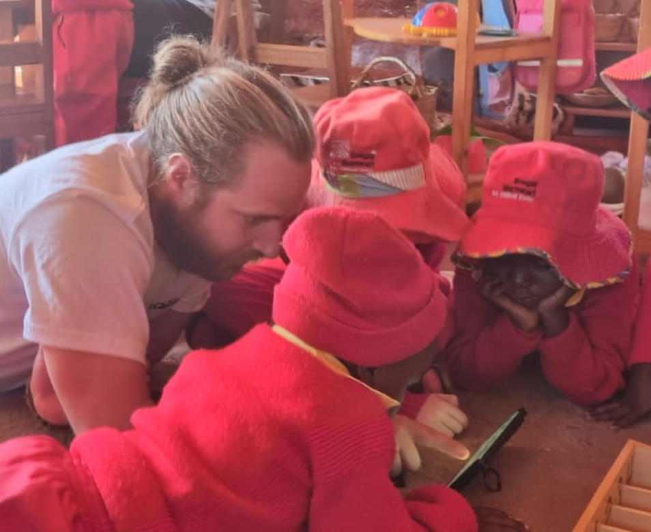
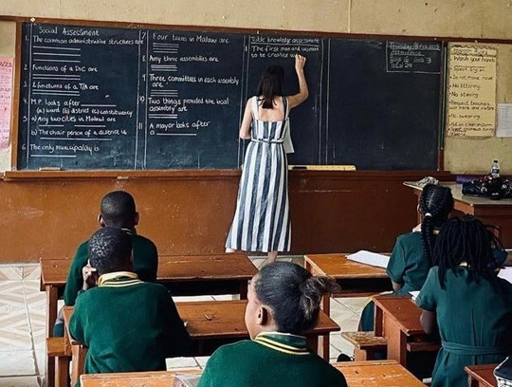
Introduction ctwp educational empowerment
Vision: Empower every child / individual on this planet through access to (free) education by using technology and thereby positively impact the world of us all
Mission:
Create an innovative school concept for underprivileged children that combines online and offline learning and integrates personalized education and real-life experiences
Current Status: At Project Phase 3 out of 5 (see video next page)
Discovery and data collection:
Visited over 150 schools and universities in more than 60 countries* to explore diverse educational models and teaching methods
Trained teachers and students on using free online education through our website and leveraging technology, incl. AI tools, to improve lesson planning, materials, and assessments
Completed courses at institutions such as Harvard and the United Nations focused on teaching methodologies and educational technology
School concept formation: Prototype / MVP has been developed
Pilot school establishment: In progress at Bongai Shamwari
Concept testing: Concept will be further developed over the next 2 years
Scaling Strategy: Strategic partnerships with other schools will be formed
Website: ctwp-educationalempowerment.jimdofree.com
*e.g. Albania, Argentina, Australia, Bahrain, Belgium, Bolivia, Botswana, Brazil, Brunei, Burundi, Canada, Chile, China, Colombia, Comores, Denmark, El Salvador, Eswatini, Fiji, France, French Guiana, Germany, Guatemala, Honduras, Ireland, Italy, Kenya, Kuwait, Laos, Lesotho, Malaysia, Mexico, Micronesia, Mozambique, Netherlands, Palau, Papua New Guinea, Paraguay, Peru, Poland, Portugal, Puerto Rico, Rwanda, Samoa, Solomon Islands, South Africa, Spain, Suriname, Switzerland, Tanzania, Thailand, Tonga, Tuvalu, Uganda, United Arab Emirates, United Kingdom, United States, Uruguay, Vanuatu, Zambia, Zimbabwe

Slide 12
Project Phases and School Concept

Slide 13
02 Project Idea
Setup & Concept

Slide 14
What?
Project Idea, Setup & Concept

Slide 15
Computer Lab at Bongai Shamwari
Objective
Establish a computer lab with 10 PCs for Grade 1 and 2 students
Purpose
Teach Digital Literacy as a standalone subject and integrate it into regular subjects
Method
Hire a digital literacy teacher and engage volunteers
Utilize free online resources to deliver content through interactive teaching strategies
Outcome
Equip young learners with essential digital skills for their future

Slide 16
Why?
Project Idea, Setup & Concept

Slide 17
Key competences required in the future
Critical Thinking, Problem-Solving and Creativity
Emotional Intelligence and Empathy
Ability to analyze situations, identify problems, and develop solutions as well as innovative ideas
Understanding and managing one's own emotions and empathizing with others
Adaptability and Flexibility
Global and Cultural Awareness
Adapting to new situations and challenges with resilience
Understanding and appreciating cultural diversity and global issues
Reading, Writing, Collaboration, and Comms
Learning to learn and Life-long Learning
Mastery of language skills, working effectively in teams, and communicating ideas clearly
Digital Literacy^{1,2}
Developing strategies and attitudes for independent and continuous learning
Proficiency in using digital tools and understanding digital environments
References: 1) https://unesdoc.unesco.org/ark:/48223/pf0000386933_eng 2) Bates, T. (2024). Teaching the Skills Needed for the Future. In: Ehlers, UD., Eigbrecht, L. (eds) Creating the University of the Future. Zukunft der Hochschulbildung - Future Higher Education. Springer VS, Wiesbaden. https://doi.org/10.1007/978-3-658-42948-5_6

Slide 18
Definition Digital Literacy
Digital literacy is the ability to use technology to find, evaluate, organize, create, and communicate information safely and responsibly.
Digital Literacy Frameworks for Education provide educational institutions with a structure and shared language and typically address the following key components¹
Basic computer skills: Fundamental skills required to use desktop and mobile applications, online services and devices
Digital problem solving: Ability to use technology for work and educational pursuits as well as social and professional networking, which includes selecting the right technology to carry out a specific task or solve a particular problem
Digital ethics: Capability to evaluate the source of digital information and recognize digital disinformation. It includes security and privacy considerations, as well as the ethical use of social media and emerging technologies such as generative AI
1
2
3
References: 1) https://www.techopedia.com/definition/digital-literacy-digital-fluency Additional resources: Digital Literacy – DQ institute

Slide 19
Importance of Digital Literacy
90%
Jobs will require DL by 2030
90m
Global digital jobs are estimated by 2030
2.7b
People are still offline
School-age children do not have internet in their homes
2/3
Digital Literacy
60%
Children surveyed around the world are exposed to cyber risks
References: 1) Link 2) Link 3) Link 4) Link 5) Link

Slide 20
Benefits
Students
Teachers
Early Skill Development
Professional Growth
Introducing digital literacy at a young age helps children develop essential skills like typing, navigating digital interfaces, and using basic software, which are foundational for future learning and careers
Training in digital literacy enhances teachers' technical skills and keeps them updated with the latest educational technology, making them more effective educators and opening up opportunities for career advancement
Enhanced Problem-Solving Abilities
Improved Classroom Engagement
By learning how to use digital tools, children improve their critical thinking and problem-solving skills, as they learn to troubleshoot simple issues and find information online
With digital tools and resources, teachers can create more interactive and engaging lessons, catering to different learning styles and helping students stay motivated and interested in the material
Safe and Responsible Use
Streamlined Teaching Processes
Teaching digital literacy early helps children understand the importance of online safety and responsible behaviour, laying the groundwork for a positive and secure digital experience
Digital literacy training enables teachers to use educational technology for tasks like grading, lesson planning, and communication with students and parents, making their work more efficient and organized

Slide 21
Risks
Students
Teachers
Teach children not to share personal details and use child-safe platforms
Cybersecurity and privacy
Use secure, privacy-compliant tools and monitor student activity
Young children may inadvertently share personal information, such as their name, address, or school details, on online platforms
Teachers must manage students' online activities by using secure platforms and handling data in accordance with privacy laws to avoid breaches of confidentiality and potential legal issues
Use content filters and pre-approve websites and apps
Exposure to inappropriate content
Regularly review and update the digital content used in class
Children may encounter inappropriate content like violence, explicit language, or unsuitable ads during online searches, videos, or games
A risk for teachers is not continuously selecting and supervising software, which could result in using tools that aren't age-appropriate for the classroom
Set screen time limits and encourage physical breaks
Over-reliance on Technology
Balance digital tools with traditional methods by incl. social activities
Prolonged screen time can cause eye strain, poor posture, reduced physical activity, and negatively affect social skills and attention span
Teachers may struggle to balance digital learning with traditional methods, risking reduced hands-on learning and interpersonal interaction.

Slide 22
How?
Project Idea, Setup & Concept

Slide 23
Three key areas for project success
Physical Setup
01
Establishment and setup of the computer lab
Concept
02
Definition of Digital Literacy curriculum and execution
Financials
03
Financing of the project

Slide 24
The first key area
Physical Setup
01
Establishment and setup of the computer lab
Concept
02
Definition of Digital Literacy curriculum and execution
Financials
03
Financing of the project

Slide 25
Physical Setup
Security
Room design
Paint the room and equip it with desks and chairs and anything else to make it a welcoming learning atmosphere
Software Security: Install and regularly update antivirus and security software to protect against malware and unauthorized access
Physical Security: Secure computers and other equipment to prevent theft
Fire Safety: Equip the room with a fire extinguisher and smoke detectors. Ensure electrical outlets are in good condition
Computer Hardware
Ship computer hardware and set it up as well as energy supply
Computer Software
Install engaging and age-appropriate educational software that promotes learning and creativity
Technical Support
Ensure that technical support is readily available in case of hardware or software issues

Slide 26
The second key area
Physical Setup
01
Establishment and setup of the computer lab
Concept
02
Definition of Digital Literacy curriculum and execution
Financials
03
Financing of the project

Slide 27
Digital Literacy curriculum
1
2
3
Basic Computer Skills
Digital Problem Solving
Digital Ethics
The fundamental abilities required to operate a computer, including using the operating system, software applications, and basic internet functions
The ability to effectively identify, analyze, and resolve issues encountered in digital environments using appropriate tools and strategies
The principles and guidelines that govern responsible and respectful behavior in digital spaces, including privacy, data security, and appropriate online conduct
Learning basic computer skills, digital problem solving, and digital ethics as a kid is crucial for thriving in today's digital world. Basic computer skills enable effective use of technology in education and future jobs. Digital problem-solving fosters critical thinking and adaptability. Digital ethics and security ensure responsible online behavior, respect for privacy, and protection from digital threats. Together, these skills prepare children for success and safety in a digital society.

Slide 28
Digital Literacy curriculum
1
2
3
Basic Computer Skills
Typing: Practice typing to improve speed and accuracy using fun games and typing programs
Using a Mouse and Keyboard: Teach how to use a mouse, touchpad, and keyboard efficiently
File Management: Basics of creating, saving, and organizing files and folders
Internet Navigation
Web Browsing: How to use a web browser, open tabs, navigate websites, and use search engines
Email: How to set up and use an email account, including composing, sending, and replying to emails
Basic Coding and Programming
Block-Based Coding: Start with visual programming languages like Scratch to introduce coding concepts
Simple Coding Projects: Gradually move to simple text-based coding using languages like Python
Digital Creation
Multimedia: Basic skills in creating and editing digital content like images, videos, and presentations
Online Collaboration: Using tools like Google Docs and other collaboration platforms for group projects
Internet Navigation
Evaluating Websites: Recognize credible sources and distinguish between reliable and unreliable information
Problem-Solving and Critical Thinking
Logical Thinking: Games and puzzles that enhance logical reasoning and problem-solving
Research Skills: How to effectively search for and evaluate information online
Emerging Technologies
Awareness of New Technologies: Introduction to concepts like AI, VR, AR, and robotics
Hands-On Experience: Opportunities to interact with and explore new technologies
Integration into Regular Subjects
Interactive Learning: Use digital tools and simulations for engaging activities in subjects like math and science, such as interactive graphs and virtual labs
Digital Projects: Incorporate digital storytelling, multimedia presentations, and online research into language, arts and social studies assignments
Creative Tools: Apply digital art and music software for creative projects in classes, enhancing students' skills in creating and sharing digital content
Online Safety
Privacy: Understanding personal information and the importance of keeping it private
Cyberbullying: How to recognize, prevent, and address cyberbullying
Digital Communication
Safe Communication: Safe practices, including interacting with known and unknown individuals online
Social Media: Responsible use of social media platforms, understanding privacy settings, and digital footprints
Ethical Use of Technology
Digital Etiquette: Understanding proper behaviour and manners in online environments
Intellectual Property: Basics of copyright, plagiarism, and respecting others' work

Slide 29
Resources - Types
Use websites that offer structured lessons and interactive activities
Educational Websites
Leverage educational apps that promote digital skills in a fun way
Apps and Games
Workshops and Clubs
Participate in coding clubs, workshops, and online courses
Website for free online education
My website can be used as a starting point for finding the appropriate material
Explore additional opportunities, e.g. where kids can collaborate on digital projects and get support from peers and mentors
Additional Resources

Slide 30
Resources - Examples
Educational Websites
Code.org: Offers a variety of free coding tutorials and activities for different age groups.
Khan Academy Kids: Provides free courses in math, reading, and more with interactive exercises designed for younger children.
TypingClub: Helps children learn touch typing with free engaging lessons and games.
Scratch: A project by MIT that lets children create interactive stories, games, and animations using a visual programming language, all for free.
National Geographic Kids: Offers free educational games, videos, and articles about science, animals, and geography.
Educational Websites
Apps and Games
Kodable: Offers free coding games that teach programming concepts to young children.
Lightbot: A free puzzle game that introduces programming logic.
Hopscotch: Allows children to create their own games and animations for free.
PBS Kids Games: Features free educational games that cover a variety of subjects.
Duolingo: A free app for learning languages through fun, interactive lessons.
Apps and Games
Workshops and Clubs
CoderDojo: A global network of free, volunteer-led, community-based programming clubs for young people.
Girls Who Code Clubs: Offers free after-school clubs for girls in grades 3-12 to learn coding and computer science.
Hour of Code: An annual event providing free one-hour coding tutorials designed for all ages.
Local Libraries: Many libraries offer free coding and digital literacy workshops for children.
Maker Faire: While not always free, many Maker Faire events offer free admission for children and have free hands-on activities.
Workshops and Clubs
Additional Resources
Coursera, edX for Kids: While Coursera itself isn't entirely free, they offer free courses for children, particularly in coding and digital skills..
Google's CS First: A free program that introduces students to computer science through video-based tutorials and activities.
FutureLearn: Partners with universities to offer free online courses, including those focused on digital literacy and coding for children.
Code Club: A global network offering free coding projects and activities for children.
YouTube Channels: Channels like CrashCourse Kids and Ted-Ed offer free educational videos on a wide range of subjects, including technology and coding.
Project Gutenberg: Offers free access to a wide range of classic children’s books, which can help improve reading and comprehension skills.
Podcasts: Free educational podcasts like "Brains On!" and "But Why" cover various STEM topics in an engaging way.
National Science Digital Library: Provides free educational resources and activities focused on science, technology, engineering, and math (STEM).
Additional Resources

Slide 31
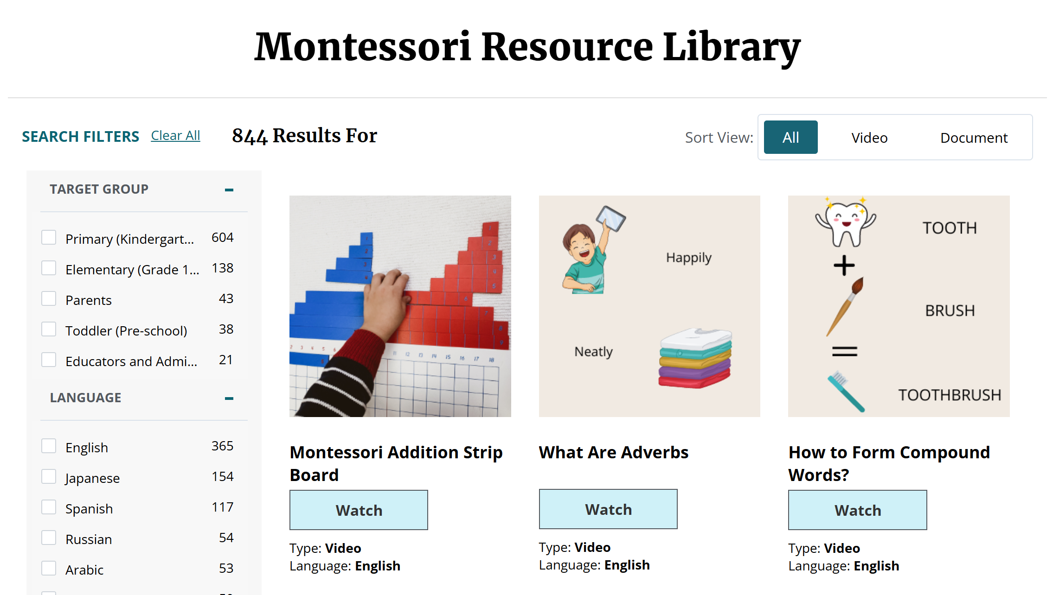
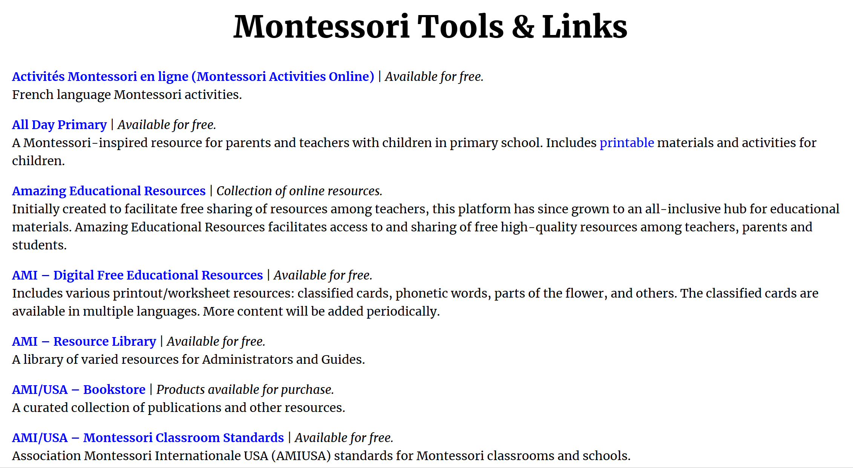
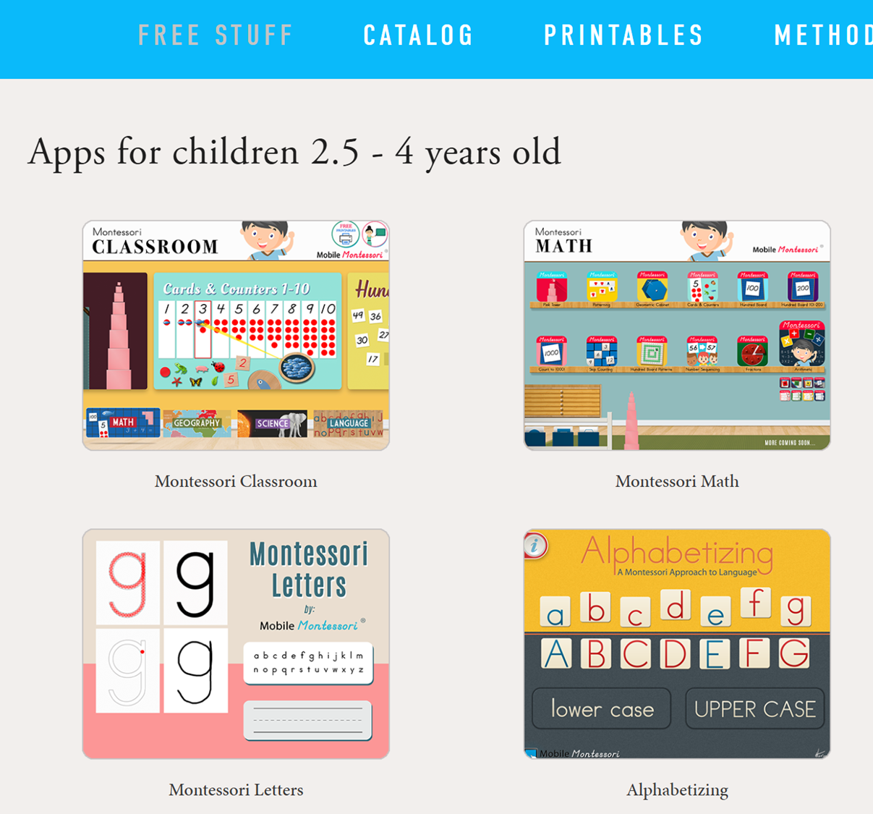
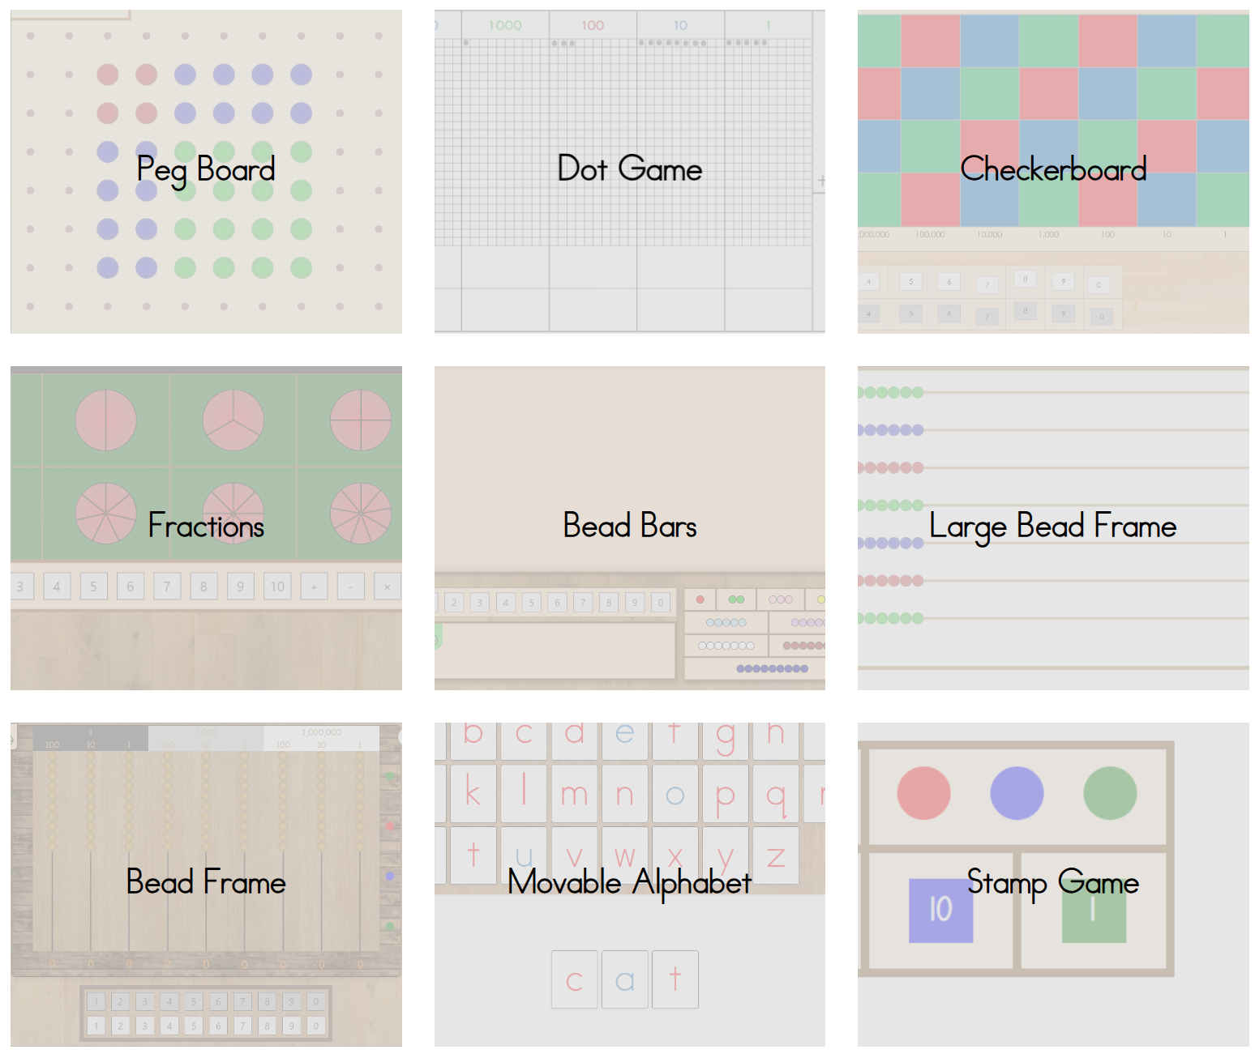
Resources - Examples Montessori Online
Digital Montessori Resources
Montessori Digital Tools:
Montessori Nature: Offers various free resources and activities inspired by Montessori principles, including digital resources and guides for integrating technology.
Montessori Apps:
Montessori Crosswords: Free app that helps kids develop language/spelling skills in a Montessori style.
Montessori Numbers: Focuses on basic math skills through interactive activities.
Free Online Platforms with Montessori Principles
Khan Academy: Although not explicitly Montessori, it provides interactive and self-paced learning in subjects like math and science, which aligns with Montessori’s emphasis on individualized learning.
ABCmouse: While not free, they occasionally offer trial periods. It’s structured similarly to Montessori with interactive and engaging content.
Montessori-Aligned Educational Websites
PBS Kids: Offers educational games and activities that can be aligned with Montessori principles, emphasizing exploration and self-directed learning.
Starfall: Provides free interactive reading and math resources that can complement Montessori methods of instruction.
DIY Montessori Computer Activities
Create Interactive Lessons: Use tools like Google Slides or Canva to create simple, interactive presentations and lessons. This aligns with Montessori’s principle of self-paced, hands-on learning.
Coding for Kids: Platforms like Scratch or Code.org offer free coding activities that encourage problem-solving and creativity, reflecting Montessori’s focus on exploration
These resources can help integrate the Montessori approach with computer-based learning in a way that's engaging and educational

Slide 32
Resources - Integration into subjects
General Learning Platforms
Khan Academy Kids: Offers engaging lessons in math, reading, and social-emotional learning.
ABCmouse: Provides a comprehensive early learning app covering reading, math, science, and art.
PBS Kids: Features educational games and videos from favorite PBS Kids shows.
Starfall: Focuses on reading, phonics, and math activities.
Coding and Technology
Code.org: Provides fun and interactive coding lessons for young children.
Scratch Jr.: A coding app designed for younger children to create their own stories and games.
Reading and Literacy
Storyline Online: Features actors reading children’s books aloud.
Epic!: Offers a huge library of books for children, free for educators.
Oxford Owl: Provides free eBooks and reading resources.
Art and Creativity
Crayola: Offers coloring pages, DIY crafts, and lesson plans.
Art for Kids Hub: YouTube channel with step-by-step drawing tutorials.
Math
Prodigy: A fun math game that covers a range of skills.
Coolmath4Kids: Games and activities that make learning math fun.
Math Playground: Offers a variety of math games and problem-solving activities.
Science
National Geographic Kids: Educational videos, games, and activities related to science and nature.
Mystery Science: Provides science lessons that spark curiosity.

Slide 33
Teaching Strategies - Examples
Interactive Learning
Games and Simulations:
Learning through Play: Use "Kahoot!" to play fun quiz games about your favorite animals or planets.
Building Fun: Play "Minecraft: Education Edition" to build your dream playground or zoo.
Interactive Tools:
Travel the World: Use "Google Earth" to visit places like the Eiffel Tower from your computer.
Science Magic: Explore "Phet Interactive Simulations" to make a virtual volcano erupt or learn how rainbows form.
Project-Based Learning
Digital Presentations:
Show and Tell: Create a slideshow with Google Slides about your favourite animal and share it with your class.
Coding Projects:
Make Your Own Game: Use "Scratch" to create a simple game and guide a character through an adventure. Multimedia Projects:
Create a Story: Make a video with iMovie or record a podcast telling a story about your favourite book.
Regular Practice
Typing Practice:
Typing Games: Practice typing with games on TypingClub to help you type faster so you can write stories quickly.
Daily Research Tasks:
Mini Research: Look up fun facts about animals using search engines to learn new things every day.
Digital Journals:
Write and Draw: Keep a digital journal on Google Docs where you can draw and write about your adventures.
Parental Involvement
Workshops for Parents:
Learn Together: Attend workshops with your parents to learn how to stay safe online/use devices responsibly.
Family Projects:
Fun Together: Create a family project, like a digital photo album of your recent trip to the park or a recipe book.
Parental Guidance:
Safe Apps: Use e.g. Common Sense Media to find which apps are great for children/how to set up safe internet rules

Slide 34
The third key area
Physical Setup
01
Establishment and setup of the computer lab
Concept
02
Definition of Digital Literacy curriculum and execution
Financials
03
Financing of the project

Slide 35
Two-year pilot budget required
Category | Type | Amount | Cost per Unit/Month (USD) | Total Cost (USD ) | Sponsor | Remark
Physical Installation | Installation PC infrastructure | 1 | 500 | '500 | Open
 | PC desks | 8 | 30 | '240 | Open | Will be produced locally to benefit the community
 | Chairs | 10 | 30 | '300 | Open | Will be produced locally to benefit the community
 | Shelf for material | 1 | 100 | '100 | Open | Will be produced locally to benefit the community
 | Room renovation | 1 | 200 | '200 | Open | The room is currently in a raw state and will require renovations before use
 | Solar battery | 1 | 2000 | 2'000 | Open
 | Solar panels | 10 | 180 | 1'800 | Open
 | Durawall | 1 | 2000 | 2'000 | Open | Will be produced locally to benefit the community
 | Security cameras | 4 | 100 | '400 | Open
 | Fence | 1 | 1500 | 1'500 | Open
 | Fan for PC room | 1 | 100 | '100 | Open
Hardware and Software Setup | PCs | 14 | N/A | Sponsored | Trelleborg AB
 | Tax for PC | 14 | 50 | '700 | Open
 | Monitor | 3 | N/A | Sponsored | Trelleborg AB
 | Monitor | 7 | 150 | 1'050 | Open
 | Mouse and keyboard | 10 | 25 | '250 | Open
 | Technical setup hardware | 1 | 300 | '300 | Open
 | Technical setup software | 1 | 200 | '200 | Open
 | Shipping | 1 | N/A | Sponsored | Trelleborg AB
 | Technical support | 24 | 25 | '600 | Open
 | Maintenance costs p.m. | 24 | 20 | '480 | Open
 | Internet Starlink | 24 | 100 | 2'400 | Open
 | Lease agreement | 24 | 60 | 1'440 | Open
Staff Salaries and Trainings | Curriculum development | 2 | 250 | '500 | Open
 | Digital Literacy teacher salary | 24 | 300 | 7'200 | Open
 | Teachers' salary top-up | 24 | 200 | 4'800 | Open
 | Ancillary personnel costs | 24 | 30 | '720 | Open | Personnel costs such as health insurance, tax, food
 | Teacher training | 4 | 200 | '800 | Open | Two days, twice a year
 | Airtime | 24 | 20 | '480 | Open | For communication with Germany
 | Volunteer | 24 | 40 | '960 | Open | Food and transportation allowance
 | Security Guard | 24 | 100 | 2'400 | Open
Contingency (~15%) |  |  |  | 5'580
Total |  |  |  | 40'000

Slide 36
03 Project Execution
How is the project brought to life (logistics, financials, timeline)?

Slide 37
Four main project steps
Setup
Curriculum
Trainings
Teaching
1.
2.
3.
4.
Computer Lab Setup
Curriculum Development
Teacher Training
Teaching Students
The setup of the computer lab provides students with the necessary technology for their lessons
The development of the curriculum ensures that it meets the educational standards and student needs
The teachers are being trained to effectively deliver the new curriculum and integrate technology into lessons
The curriculum is being taught to students with the goal of enhancing their understanding and skills in the subject matter

Slide 38
Project Timeline
As of 15.12.24
Management | 2024 |  | 2025 |  |  |  |  |  |  |  |  |  |  |  | 2026
 | Nov 24 | Dec 24 | Jan 25 | Feb 25 | Mar 25 | Apr 25 | May 25 | Jun 25 | Jul 25 | Aug 25 | Sep 25 | Oct 25 | Nov 25 | Dec 25 | Jan 26 | Feb 26 | Mar 2 | Year 26
Project Management
Physical Setup
DL Curriculum
Teachers + Volunteer
Students
Parents
Alumni
Community
Raise funds
Select Software
Prepare PCs
Ship PCs
Set up PCs
Lab ready
Technical support
Room creation
30.06
Develop student curriculum
Improve curriculum
Develop teacher curriculum
Recruit Digital Literacy teacher & volunteer
Train teachers + volunteers
15.08
Test
Teacher & Volunteer
Learn Digital Literacy
20.12
Learn Digital Literacy
Test
Students
Inform parents
Prepare session
15.01
Start activity parents & students
Session
Parents
Develop plan
Develop plan
Today
Start Teaching

Slide 39
Potential outlook
2026 - Access for Community
Community members will be able to use the computer lab outside school hours
3
2026 - Access for Alumni of Bongai Shamwari
2
Alumni students will be able to use the computer lab outside school hours
1
2025 - Access for Students of Bongai Shamwari
1st and 2nd grade students start learning about Digital Literacy

Slide 40
04 Appendix
Additional Information

Slide 41
Online Learning Benefits
Access to a Wealth of Information
Variety of Resources: Platforms like Khan Academy offer free educational videos and exercises on a wide range of subjects.
Up-to-Date Information: Newsela provides current event articles tailored to different reading levels, keeping students informed with the latest news.
Flexibility and Convenience
Self-Paced Learning: Coursera for Kids allows children to take courses at their own pace, making learning more manageable.
Anytime, Anywhere Learning: Platforms like Duolingo enable children to learn languages on the go, whether they are at home or traveling.
Personalized Learning Experiences
Adaptive Learning: DreamBox Learning adapts math lessons based on the child's progress and learning style.
Choice of Topics: TED-Ed offers lessons on a variety of topics, allowing students to explore areas of interest beyond the standard curriculum.
Development of Digital Skills
Technical Proficiency: Using tools like Google Workspace helps children become proficient in digital communication and collaboration.
Information Literacy: Research projects using online databases like JSTOR teach students how to search for, evaluate, and use information responsibly.
Interactive and Engaging Content
Multimedia: Platforms like BrainPOP use animated videos and interactive quizzes to make learning engaging and fun.
Gamification: Prodigy Math Game incorporates game elements to motivate students and keep them interested in math.
Collaboration and Communication
Online Collaboration Tools: Google Classroom facilitates group projects and collaborative learning by allowing students to work together on shared documents
Global Connections: ePals connects students with peers from around the world for cultural exchange and collaborative projects.

Slide 42
Online Learning Risk & Mitigation
Screen Time and Health Issues
Eye Strain: Encourage regular breaks using the 20-20-20 rule (every 20 minutes, take a 20-second break to look at something 20 feet away). Use apps like EyeLeo to remind children to take breaks.
Physical Health: Promote a balanced schedule that includes physical activities. Integrate exercise apps like GoNoodle into daily routines to keep children active.
Distractions and Lack of Focus
Non-Educational Content: Use websites blockers like Cold Turkey to limit access to distracting or unsecure website.
Multitasking: Teach time management skills and use tools like Focus@Will to help kids stay focused on their tasks.
Privacy and Security Concerns
Data Privacy: Educate children about online privacy and use parental/teacher control software like Qustodio to monitor and control online activities.
Cyberbullying: Encourage open communication about online experiences and use platforms with strong moderation and reporting features, like KidzWorld.
Quality and Credibility of Information
Misinformation: Teach critical thinking and source evaluation skills. Use reputable resources like Common Sense Media to help children identify credible information.
Source Evaluation: Provide guidance on how to cross-check information using multiple reliable sources and encourage the use of fact-checking websites like Snopes.
Social Isolation
Reduced Face-to-Face Interaction: Schedule regular in-person group activities or virtual meetups to foster social interaction. Platforms like Zoom can be used for virtual playdates and group study sessions.
Loneliness: Encourage participation in extracurricular activities, both online and offline, to maintain a sense of community and connection.
Technical Issues
Access to Technology: Work with schools and community organizations to provide devices and internet access to students in need. Programs like EveryoneOn offer affordable internet solutions.
Technical Difficulties: Ensure a basic understanding of troubleshooting common tech issues and maintain a list of resources for technical support. Encourage the use of reliable platforms with good customer support, like Google Classroom.
Additional resources: Digital Literacy – DQ institute

